Slide 1
Data Structures and algorithms SPARSE MATRIX

Slide 2
SPARSE MATRIX – DATA STRUCTURE
In computer programming, a matrix can be defined with a 2-dimensional array. Any array with 'm' columns and 'n' rows represent a m X n matrix.
There may be a situation in which a matrix contains more number of ZERO values than NON-ZERO values. Such matrix is known as sparse matrix.
“Sparse matrix is a matrix which contains very few non-zero elements”

Slide 3
SPARSE MATRIX – DATA STRUCTURE
When a sparse matrix is represented with a 2-dimensional array, we waste a lot of space to represent that matrix.
For example, consider a matrix of size 100 X 100 containing only 10 non-zero elements. In this matrix, only 10 spaces are filled with non-zero values and remaining spaces of the matrix are filled with zero.
That means, totally we allocate 100 X 100 X 2 = 20000 bytes of space to store this integer matrix.
And to access these 10 non-zero elements we have to make scanning for 10000 times. To make it simple we use the following sparse matrix representation.

Slide 4
SPARSE MATRIX – DATA STRUCTURE
Sparse Matrix Representations
A sparse matrix can be represented by using TWO representations, those are as follows :
Triplet Representation (Array Representation)
Linked Representation

Slide 5
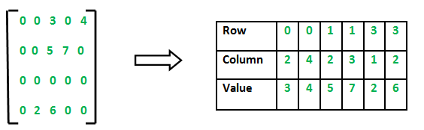
SPARSE MATRIX – DATA STRUCTURE
Triplet Representation (Array Representation)
In this representation, we consider only non-zero values along with their row and column index values. In this representation, the 0th row stores the total number of rows, total number of columns and the total number of non-zero values in the sparse matrix. For example, consider a matrix of size 4 X 5 containing 6 number of non-zero values. This matrix can be represented as shown in the figure.

Slide 6
SPARSE MATRIX – DATA STRUCTURE
In above example matrix, there are only 6 non-zero elements (those are 9, 8, 4, 2, 5 & 2) and matrix size is 5 X 6.
We represent this matrix as shown in the above image. Here the first row in the right side table is filled with values 5, 6 & 6 which indicates that it is a sparse matrix with 5 rows, 6 columns & 6 non-zero values.
The second row is filled with 0, 4, & 9 which indicates the non-zero value 9 is at the 0th-row 4th column in the Sparse matrix. In the same way, the remaining non-zero values also follow a similar pattern.

Slide 7
SPARSE MATRIX – DATA STRUCTURE
Array Based Implementation in C++
#include<iostream>
using namespace std;
void main()
{
// Assume 4x5 sparse matrix
int sparseMatrix[4][5] = {
{0 , 0 , 3 , 0 , 4 },
{0 , 0 , 5 , 7 , 0 },
{0 , 0 , 0 , 0 , 0 },
{0 , 2 , 6 , 0 , 0 }};

Slide 8
SPARSE MATRIX – DATA STRUCTURE
int size = 0;
for (int i = 0; i < 4; i++)
for (int j = 0; j < 5; j++)
if (sparseMatrix[i][j] != 0)
size++;
// number of columns in compactMatrix (size) must be
// equal to number of non - zero elements in
// sparseMatrix
int compactMatrix[3][size];
// Making of new matrix
int k = 0;
for (int i = 0; i < 4; i++)
for (int j = 0; j < 5; j++)
if (sparseMatrix[i][j] != 0)
{
compactMatrix[0][k] = i;
compactMatrix[1][k] = j;
compactMatrix[2][k] = sparseMatrix[i][j];
k++;
}
for (int i = 0; i < 3; i++)
{
for (int j = 0; j < size; j++)
cout<<compactMatrix[i][j];
}
}

Slide 9
SPARSE MATRIX – DATA STRUCTURE
Linked Representation
In linked representation, we use a linked list data structure to represent a sparse matrix. In linked list, each node has four fields. These four fields are defined as:
Row: Index of row, where non-zero element is located
Column: Index of column, where non-zero element is located
Value: Value of the non zero element located at index – (row, column)
Next node: Address of the next node

Slide 10
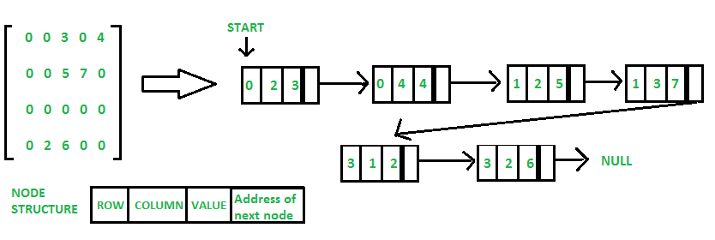
SPARSE MATRIX – DATA STRUCTURE

Slide 11
SPARSE MATRIX – DATA STRUCTURE
// Node to represent sparse matrix
struct Node
{
int value;
int row_position;
int column_postion;
struct Node* next;
};
// Function to create new node
void create_new_node(struct Node** start, int non_zero_element,
int row_index, int column_index)
{
struct Node* temp, * r;
temp = *start;

Slide 12
SPARSE MATRIX – DATA STRUCTURE
if (temp == NULL)
{
// Create new node dynamically
temp = (struct Node*) malloc(sizeof(struct Node));
temp->value = non_zero_element;
temp->row_position = row_index;
temp->column_postion = column_index;
temp->next = NULL;
*start = temp;
}
else
{
while (temp->next != NULL)
temp = temp->next;
// Create new node dynamically
r = (struct Node*) malloc(sizeof(struct Node));
r->value = non_zero_element;
r->row_position = row_index;
r->column_postion = column_index;
r->next = NULL;
temp->next = r;
}}
// This function prints contents of linked list
// starting from start
void PrintList(struct Node* start)
{
struct Node* temp, * r, * s;
temp = r = s = start;
cout<<"row_position: ";
while (temp != NULL)
{
cout << temp->row_position;
temp = temp->next;
}
cout << "column_postion: ";
while (r != NULL)
{
cout << r->column_postion;
r = r->next;
}
cout << "Value: ";
while (s != NULL)
{
cout << s->value;
s = s->next;
}
}

Slide 13
SPARSE MATRIX – DATA STRUCTURE
void main()
{// Assume 4x5 sparse matrix
int sparseMatric[4][5] = {
{0 , 0 , 3 , 0 , 4 },
{0 , 0 , 5 , 7 , 0 },
{0 , 0 , 0 , 0 , 0 },
{0 , 2 , 6 , 0 , 0 }
};
/* Start with the empty list */
struct Node* start = NULL;
for (int i = 0; i < 4; i++)
for (int j = 0; j < 5; j++)
// Pass only those values which are non - zero
if (sparseMatric[i][j] != 0)
create_new_node(&start, sparseMatric[i][j], i, j);
PrintList(start);
}

Slide 14
SPARSE MATRIX – DATA STRUCTURE
Why to use Sparse Matrix instead of simple matrix ?
Storage: There are lesser non-zero elements than zeros and thus lesser memory can be used to store only those non-zero elements.
Computing time: Computing time can be saved by logically designing a data structure traversing only non-zero elements.

Slide 15
SPARSE MATRIX – DATA STRUCTURE
Operations of Sparse Matrix
Add
Transpose and
Multiply
Given two sparse matrices, perform the operations such as add, multiply or transpose of the matrices in their sparse form itself.
The result should consist of three sparse matrices, one obtained by adding the two input matrices, one by multiplying the two matrices and one obtained by transpose of the first matrix.
Example: Note that other entries of matrices will be zero as matrices are sparse.

Slide 16
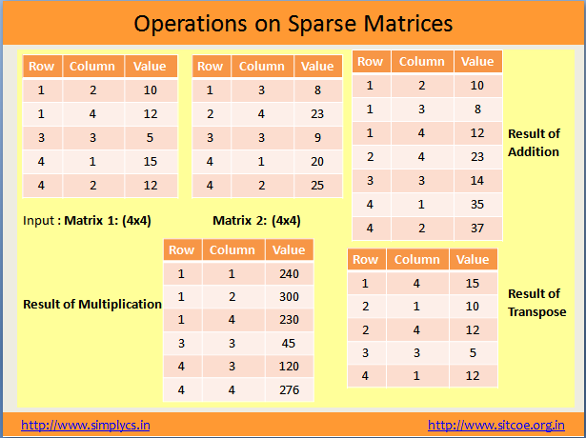
SPARSE MATRIX – DATA STRUCTURE

